Slide 1
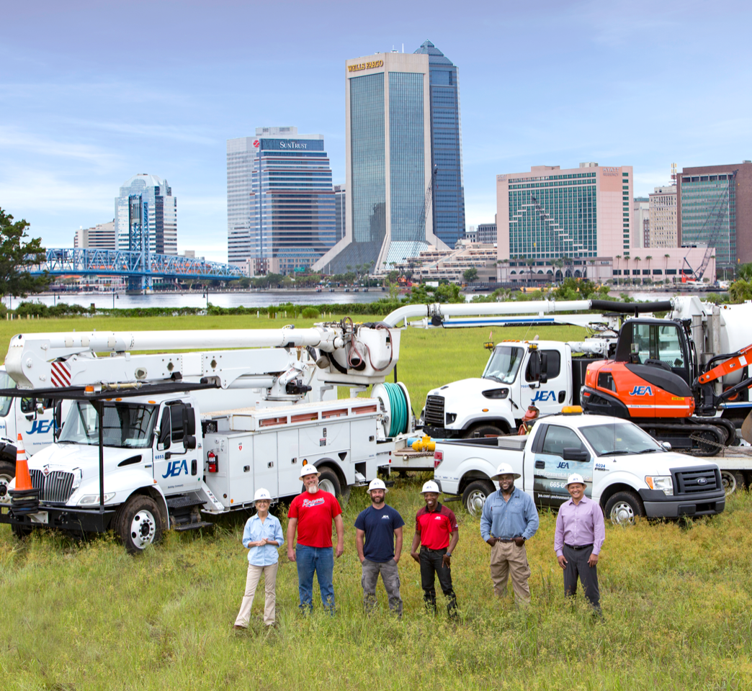


Water Reuse and Treatment Facilities
Site Specific Safety Training
Updated: September 2022

Slide 2


Daily Safety Briefing
The supervisor, lead person, or foreman is required to conduct a Job Safety Briefing prior to beginning work with the crew to discuss the hazards that are present for the day’s tasks and the proper controls for each hazard identified.
Situational awareness, hazard recognition, and being in the moment should be a focus of daily briefing details since the hazards can change.
In the case of an evacuation, the Contractor will be responsible for accounting for all their personnel and communicating the status of their employees to the Contractor Sponsor.

Slide 3
JEA Safety Rules
Use of JEA equipment by contractors is strictly prohibited, including but not limited to:
  Heavy equipment
  Tools
  Miscellaneous shop equipment
  Etc.
Contractor employees are prohibited from JEA shops & buildings unless accompanied by a JEA employee or written permission from the Contractor Sponsor.

Slide 4
Known Hazards
JEA WRF’s have many known and unknown hazards and it is the responsibility of the Contractor to ensure their employees are trained in hazard recognition and mitigation to ensure their employees are not injured.
Known hazards on WRF’s include:
  High levels of Hydrogen Sulfide (H2S)
  Entrapment (Confined Spaces and Bar Screens)
  Falls (from height and through openings on the ground)
  Large quantiles of chemicals to include hydrogen peroxide and Sodium hypochlorite
  High intensity Ultraviolet (UV) lights
  Moving equipment

Slide 5
High Injury Potential Areas/Activities
Slips, Trips, and Falls (STF)
Hot Work: Welding, torch cutting, spark generating work, etc.
Struck By: Moving machinery, vehicles, swinging supplies
Hazardous Energy: Electricity, pressure (water, air, hydraulics), steam, etc.
Housekeeping
Falls: Working at heights, ladders, etc.
100% Fall Protection at 4’ and over on ALL JEA projects.
Full body harness & fall arrest anchorage required.

Slide 6
PPE Requirements
SAFETY TOED WORK BOOTS, HARD HAT, AND PROTECTIVE SAFETY EYEWEAR ARE THE MINIMUM PPE REQUIRED TO BE WORN AT ALL TIMES ON JEA WORK SITES !!!
Hard Hats:
  ANSI approved
  Brim forward (except Welders when welding)
  No paint, holes or defects
  Contractor ID

Slide 7

PPE Requirements, cont.
Safety Toed Boots:
  Leather or similar material
  Defined heel
  Electrical Hazard (EH) Rating
  Ankle support 5” upper
  Slip resistant soles
  Protective toe meets ASTM F2413 standard
  Other guards where required depending on the hazards

Slide 8

PPE Requirements, cont.
Safety Glasses:
  ANSI approved lenses
  Side shields
  Goggles where needed
  Prescription lenses OK if ANSI or inserted/covered by ANSI safety glasses
  Face Shields are required when exposed to over-spray, chemical splash, chipping, grinding, abrading, etc.
  Safety glasses must be worn under face shields
  Project/Task Specific PPE will vary from task to task

Slide 9
Emergency Response & Notification
For any incident requiring immediate emergency care call 911.
Supervisor, lead person, or foreman shall call the JEA Contractor Sponsor and/or the necessary emergency numbers as needed:
  Security emergencies (904) 665-6200
  Environmental emergencies (904) 620-9921
All injuries, incidents, and Near Misses shall be reported regardless of how minor they seem.

Slide 10
Scaffold Safe Work Practice
Follow all instructions given by the Competent Person.
Know how to inspect all parts of the scaffold and scaffold base.
Never climb on a scaffold that has not been cleared to use.
Look for scaffolding tags - Red, Yellow, & Green.

Slide 11
Water Reuse and Treatment Facilities
JEA Operates 5 Water Reuse and Treatment Facilities and 3 Regional Treatment Facilities
The Safety Objective at each site is:
To create a seamless, interdependent safety and health promotion organization which promotes and ensures the core values and business strategies of JEA, regardless of actual employer and maximizes resources and expertise to reduce injury and illness within JEA and the community.
Safety is everyone’s responsibility!

Slide 12
Cedar Bay WRF
Unique Hazards Include: High levels of H2S, especially at the bar screens.
Alarms: None at the plant, Contractor shall develop a process for alerting their employees in the event of an emergency
Assembly Location: Front Gate
Hazardous Energy Controls (LOTO): See Plant Operations for LOTO procedure and locks for use
Check In Process: Contractors shall use their badge to gain access to work
Traffic: Cedar Bay Road leading into the WRF is 2-lane, 35 mph road with lots of residential homes and bus stops. Do not exceed posted plant speed

Slide 13
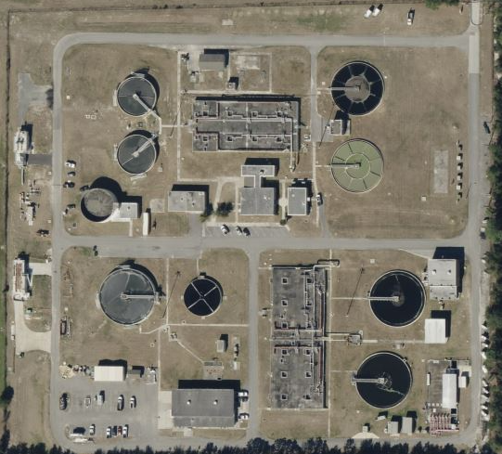
Cedar Bay WRF
4
1- Plant Operations
2- Maintenance Shop
3- Bar Screens
4- Main Gate off Cedar Bay Road
1
3
2

Slide 14
Nassau WRF
Unique Hazards Include: High levels of H2S, especially at the bar screens.
  Operations is the point of contact for any work around chemical tanks as well as spill prevention and mitigation
Alarms: None at the plant, Contractor shall develop a process for alerting their employees in the event of an emergency
Assembly Location: Front Gate
Hazardous Energy Controls (LOTO): See Plant Operations for LOTO procedure and locks for use
Check In Process: Contractors shall use their badge to gain access to work
Traffic: Do not exceed posted plant speed

Slide 15
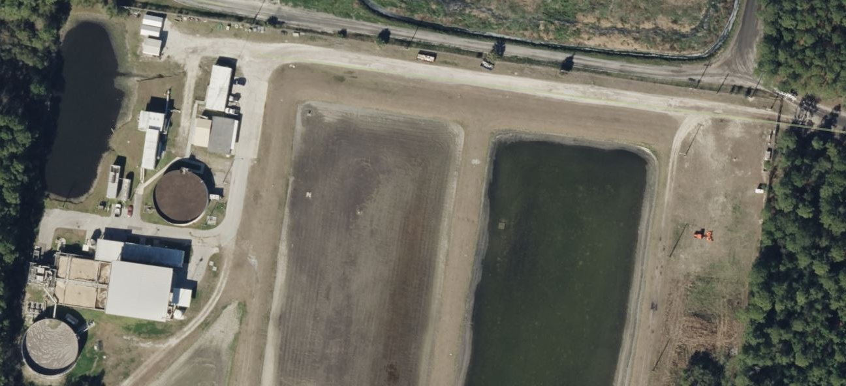
Nassau WRF
4
2
1- Plant Operations
2- Maintenance Shop
3- Bar Screens
4- Main Gate off Amelia Concourse
1
3

Slide 16
118th Street WRF
Unique Hazards Include: High levels of H2S, especially at headworks.
Alarms: None at the plant, Contractor shall develop a process for alerting their employees in the event of an emergency
Assembly Location: The west gate on 118th Street near Ops Building
Hazardous Energy Controls (LOTO): LOTO procedures and locks are located in the Operations Building lobby. Operations group is responsible for LOTO on the facility.
Check In Process: Once permitted onto plant, no further need to check-in
Traffic: Do not exceed posted plant speed

Slide 17
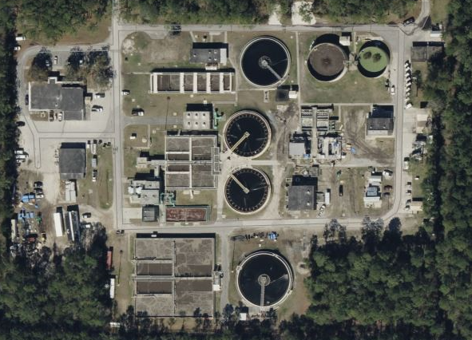
118th Street WRF
2
1
1- Plant Operations
2- West Gate on 118th St.
3- Headworks
4- Hypochlorite Solution
4
3

Slide 18
Mandarin WRF
Unique Hazards Include: High levels of H2S at bar screens
Alarms: None at the plant, Contractor shall develop a process for alerting their employees in the event of an emergency
Assembly Location: Main entry gate on the east side of the facility.
Hazardous Energy Controls (LOTO): JEA Operators will lock and tag out equipment. Contractors can place their locks and tags as well.
Check In Process: Yes, with O&M staff depending on work being performed
Traffic: Do not exceed posted plant speed limit and don’t tailgate into the plant

Slide 19
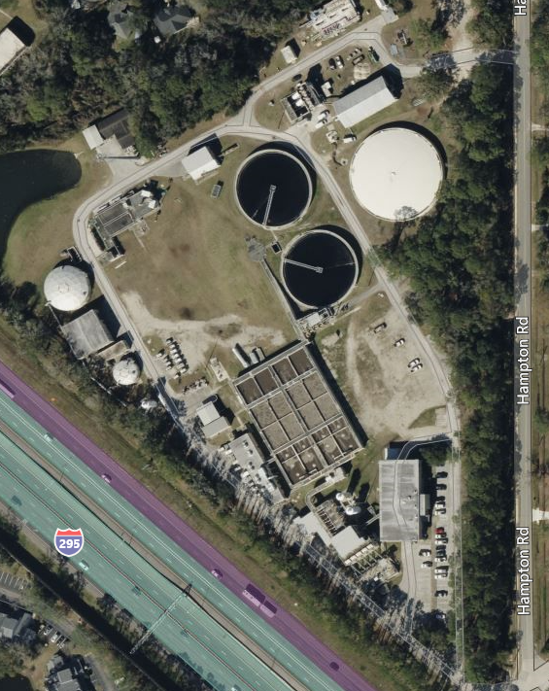
Mandarin WRF
1- Plant Operations
2- Main gate
3- Bar Screens
1
3
2

Slide 20
Monterey WRF
Unique Hazards Include: None identified- Communication is paramount
Alarms: None at the plant, Contractor shall develop a process for alerting their employees in the event of an emergency
Assembly Location: Flagpole
Hazardous Energy Controls (LOTO): LOTO request, LOTO Document filled out, Tags zip tied on valves, Clasp Tags zip tied on breakers.
Check In Process: Contractor foreman meets with Ops/Team Lead before beginning work and at end of day or project.

Slide 21
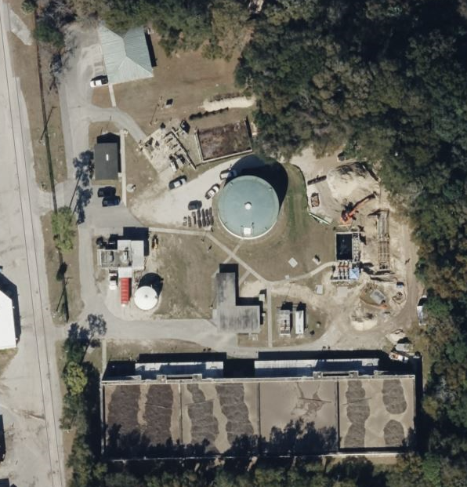
Monterey WRF
1
3
2
1- Plant Operations
2- Main gate
3- Flagpole

Slide 22
Arlington East WRF
Unique Hazards Include:
Alarms:
Assembly Location:
Hazardous Energy Controls (LOTO):
Check In Process:

Slide 23
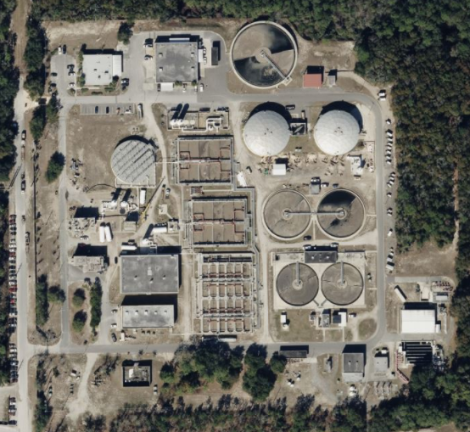
Arlington East WRF
1
2
1- Plant Operations
2- Main gate
3-
3

Slide 24
Blacksford WRF
Unique Hazards Include:
Alarms:
Assembly Location:
Hazardous Energy Controls (LOTO):
Check In Process:

Slide 25
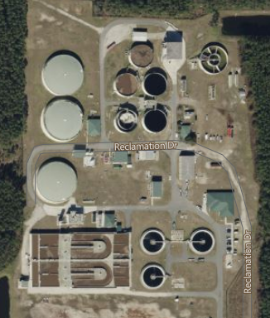
Blacksford WRF
1- Plant Operations
2- Main gate
3-
3
1
2

Slide 26
Julington Creek WRF
Unique Hazards Include:
Alarms:
Assembly Location:
Hazardous Energy Controls (LOTO):
Check In Process:

Slide 27
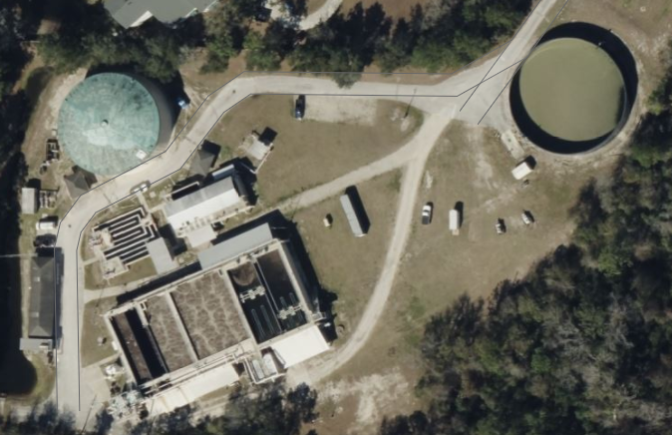
Julington Creek WRF
2
1- Plant Operations
2- Main gate
3-
3
1

Slide 28
WRF
Unique Hazards Include:
Alarms:
Assembly Location:
Hazardous Energy Controls (LOTO):
Check In Process:

Slide 29
Monteray WRF
1
1- Plant Operations
2- Main gate
3- Flagpole
3
2

Slide 30
Questions, cont.?
If you have any questions, please contact your:
Supervisor
Plant Operations
JEA Safety Specialist for water/wastewater treatment and reuse:
  Roger Parker: (904) 349-6108
JEA Safety Specialist for water delivery and collection (PSSC):
  Jim Fisher: (904) 229-5045
JEA Contractor Sponsor
Safety@jea.com
JEA Safety & Health Services Team Member (904) 665-4878

